Slide 1
대구교육청 X Microsoft Copilot Prompthon Pitch Deck
조이름

Slide 2
Introduction & Ground Rule
4-6명이 한 팀이 되어 진행
업무에 바로 적용 가능한 실용적인 AI 활용 사례를 도출
구체적인 기대효과(ROI)를 도출하기
우수 시나리오를 조직 내 다른 구성원에게 전파하여 Copilot 활용 문화를 자연스럽게 확산
Notes:
How to get started? Just about every function can benefit from AI, the key is to pick a process and get started. For example, improving case handling time for customer service, or streamlining creative development in marketing or speeding up the product development process.
Prioritize training, adoption and change management. Getting tangible business benefits from AI isn’t going to happen by just turning it on, employees need tangible user enablement programs to be successful.
And along the way we help you understand how AI is being used across your organization, how different groups and functional areas use AI differently, where further enablement and best practices could drive even more impact, and measure the impact across your organization.

Slide 3

평가 기준
창의성 | 30%
실행 가능성 | 40%
기술 완성도 | 30%
기존 방식과 차별화된 창의적 접근인가?
학생, 교사 및 행정 업무에 실질적으로 적용 가능한가?
M365 앱과 Copilot의 연계 활용도
Notes:
Why have we been seeing this momentum? Great products start with obsessing over customers needs. We built Teams Premium to solve for the top pain points we have been hearing from customers as they navigate the new challenges and opportunities of hybrid work. What are some of those ingoing needs we set out to solve?
Ever year Microsoft surveys thousands of workers around the globe as part of our Work Trend Index research. The message from workers was clear: they say that having multiple or inefficient meetings is the number 1 disruptor to their productivity.
They want tools to be able to catch up and focus on what matters the most.
Over 80% of enterprises moving toward a hybrid workplace. Many of us, myself included, really appreciate the flexibility that comes with hybrid work. However, n this new hybrid work paradigm, IT Admins have become increasingly concerned about information leakage and other emerging security threats. Our most recent Work Trend Index found that cyber security and data privacy is the #1 concern among leaders.
People are in 3X more Teams meetings and calls per week both internal and external. They want to tailor these virtual interactions with specific customization and richer engagements.

Slide 4
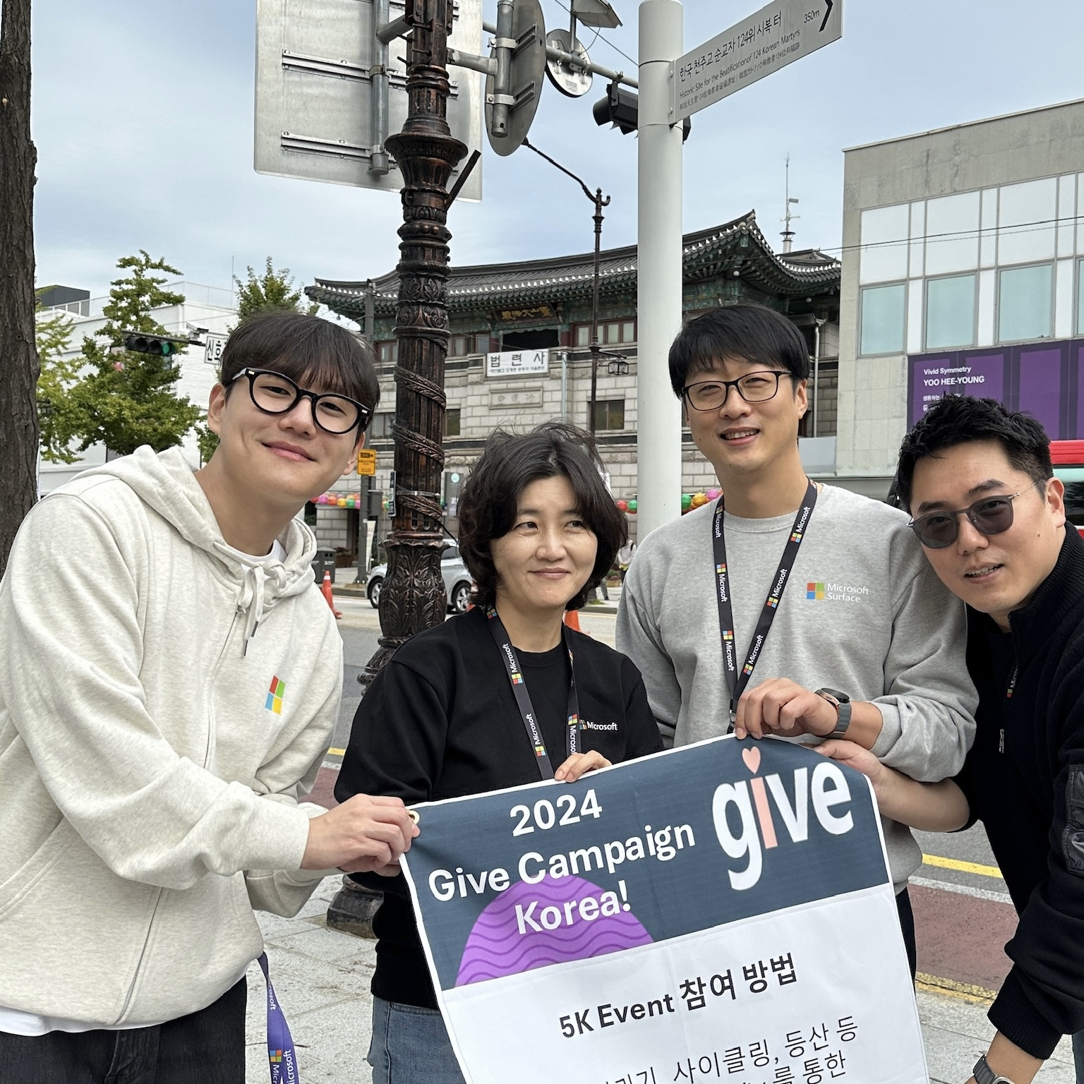
팀이름
우리 팀 소개
Notes:
The data is clear: People are overwhelmed with digital debt and under duress at work.
Our latest WTI reports find that people need to read 4 emails for every 1 they send. Teams meetings have increased 3x since 2020.
The good news is that people are finding relief by using AI.
Already, AI is being woven into the workplace at an unexpected scale. As previously mentioned, 75% of knowledge workers use AI at work today.
It’s paying off, based on insights from the 2024 Work Trend Index, a survey by Microsoft and LinkedIn from a sample set of 31,000 people across 31 countries.
Users say AI helps them save time (90%), focus on their most important work (85%), be more creative (84%), and enjoy their work more (83%).
So how can your organization harness this promising results for employee productivity?
More findings from the report:
https://www.microsoft.com/en-us/worklab/work-trend-index/ai-at-work-is-here-now-comes-the-hard-part

Slide 5
제안 배경
조직 구성원, 규모 (인사 조직, 20명)
러닝 엑셀러레이터 및 코파일럿이 대신 수행 할 수 있는 업무 시나리오 발견
해당 업무의 주당 소요 업무 시간 파악
해당 업무의 어려움, 고충 및 문제점 등…

Slide 6

코파일럿 시나리오
사용한 M365 Apps
사용된 프롬프트
결과물 등..

Slide 7
기대효과
ROI 분석을 위해 비용 대비 절감된 시간과 생산성 향상 효과를 계산합니다.
ROI(%) = ((Copilot 도입 후 절감된 비용 - Copilot 도입 비용) / Copilot 도입 비용) × 100
도입 비용: M365 Copilot 라이선스 (예: 30명 × $30 × 12개월 = $10,800)
절감효과: 업무 자동화로 1명당 주당 3시간 절감 → 연간 30명 × 3시간 × 52주 = 4,680시간 절감. 직원 평균 시급을 $20로 가정 → $93,600 절감 효과
ROI 계산하기: ROI = ((93,600 - 10,800) / 10,800) × 100 = 767%
최종 기대 효과: Copilot 도입을 통해 7배 이상의 비용 대비 절감 효과가 발생할 수 있음.

Slide 8
LIVE 시연
Notes:
Let’s see it in action.

